Slide 1
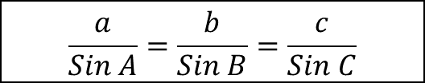
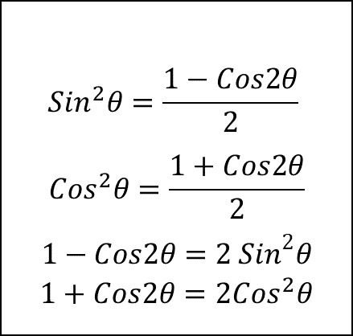
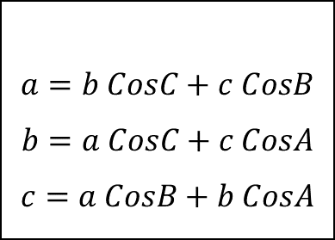
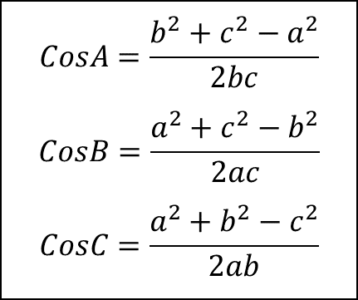
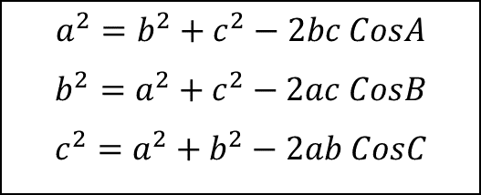
Trigonometric Formulas & Identities
$$a^{2}=b^{2}+c^{2}−2bc CosA$$
$$b^{2}=a^{2}+c^{2}−2ac CosB$$
$$c^{2}=a^{2}+b^{2}−2ab CosC$$
$$CosA=\frac{b^{2}+c^{2}−a^{2}}{2bc}$$
$$CosB=\frac{a^{2}+c^{2}−b^{2}}{2ac}$$
$$CosC=\frac{a^{2}+b^{2}−c^{2}}{2ab}$$
$$\frac{a}{Sin A}=\frac{b}{Sin B}=\frac{c}{Sin C}$$
$$a=b CosC+c CosB$$
$$b=a CosC+c CosA$$
$$c=a CosB+b CosA$$
$${Sin}^{2}θ=\frac{1−Cos2θ}{2}$$
$${Cos}^{2}θ=\frac{1+Cos2θ}{2}$$
$$1−Cos2θ=2 {Sin}^{2}θ$$
$$1+Cos2θ=2{Cos}^{2}θ$$

Slide 2
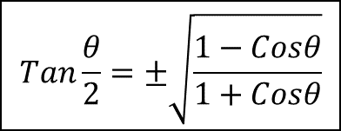
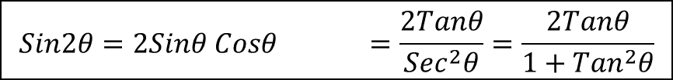
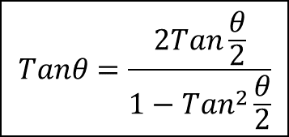
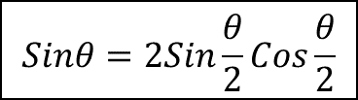
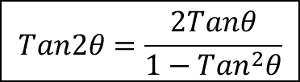
$$Cos2θ=1−2{Sin}^{2}θ =2{Cos}^{2}θ−1 ={Cos}^{2}θ−{Sin}^{2}θ =\frac{1−{Tan}^{2}θ}{1+{Tan}^{2}θ}$$
$$Sin2θ=2Sinθ Cosθ =\frac{2Tanθ}{{Sec}^{2}θ}=\frac{2Tanθ}{1+{Tan}^{2}θ}$$
$$Tan2θ=\frac{2Tanθ}{1−{Tan}^{2}θ}$$
$$Cosθ=1−2{Sin}^{2}\frac{θ}{2} =2{Cos}^{2}\frac{θ}{2}−1 ={Cos}^{2}\frac{θ}{2}−{Sin}^{2}\frac{θ}{2}$$
$$Sinθ=2Sin\frac{θ}{2}Cos\frac{θ}{2}$$
$$Tanθ=\frac{2Tan\frac{θ}{2}}{1−{Tan}^{2}\frac{θ}{2}}$$
$$Tan\frac{θ}{2}=±\sqrt{\frac{1−Cosθ}{1+Cosθ}}$$

Slide 3
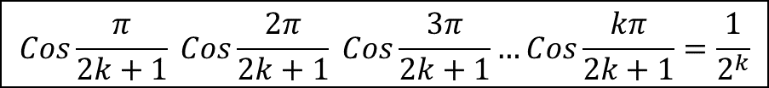
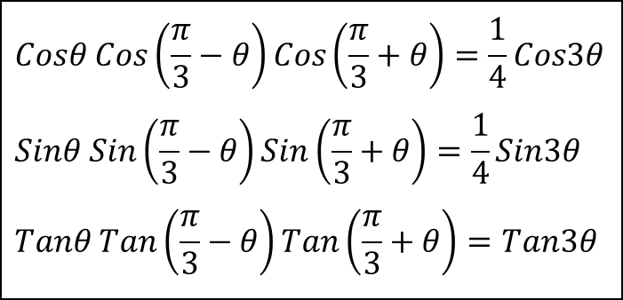
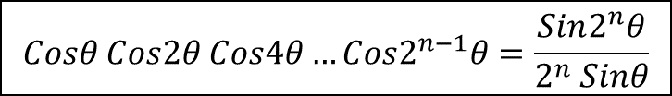
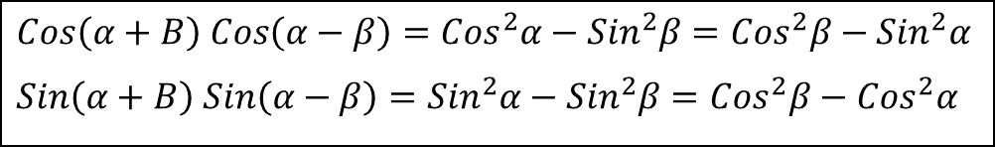
$$Cosθ Cos2θ Cos4θ…Cos2^{n−1}θ=\frac{Sin2^{n}θ}{2^{n} Sinθ}$$
$$Cos\frac{π}{2k+1} Cos\frac{2π}{2k+1} Cos\frac{3π}{2k+1}…Cos\frac{kπ}{2k+1}=\frac{1}{2^{k}}$$
$$Tanθ+2 Tan2θ+4 Tan4θ+…+2^{n−1} Tan2^{n−1}θ+2^{n} Cot2^{n}θ=Cotθ$$
$$Tan\left(A+B+C\right)=\frac{TanA+TanB+TanC+TanA TanB TanC}{1−TanA TanB−TanB TanC−TanC TanA}$$
$$Cos\left(α+B\right) Cos\left(α−β\right)={Cos}^{2}α−{Sin}^{2}β={Cos}^{2}β−{Sin}^{2}α$$
$$Sin\left(α+B\right) Sin\left(α−β\right)={Sin}^{2}α−{Sin}^{2}β={Cos}^{2}β−{Cos}^{2}α$$
$$Cosθ Cos\left(\frac{π}{3}−θ\right)Cos\left(\frac{π}{3}+θ\right)=\frac{1}{4}Cos3θ$$
$$Sinθ Sin\left(\frac{π}{3}−θ\right)Sin\left(\frac{π}{3}+θ\right)=\frac{1}{4}Sin3θ$$
$$Tanθ Tan\left(\frac{π}{3}−θ\right)Tan\left(\frac{π}{3}+θ\right)=Tan3θ$$

Slide 4
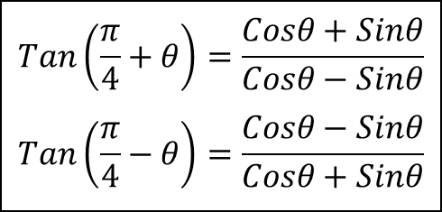
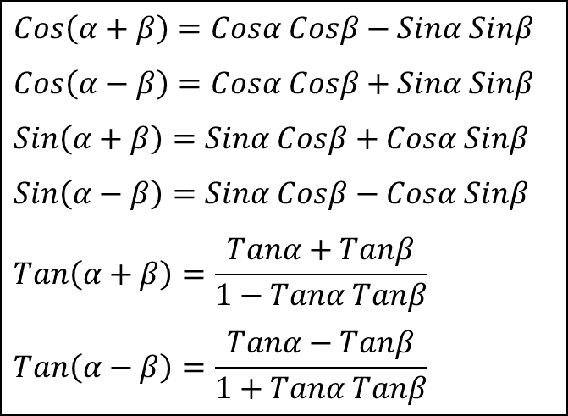
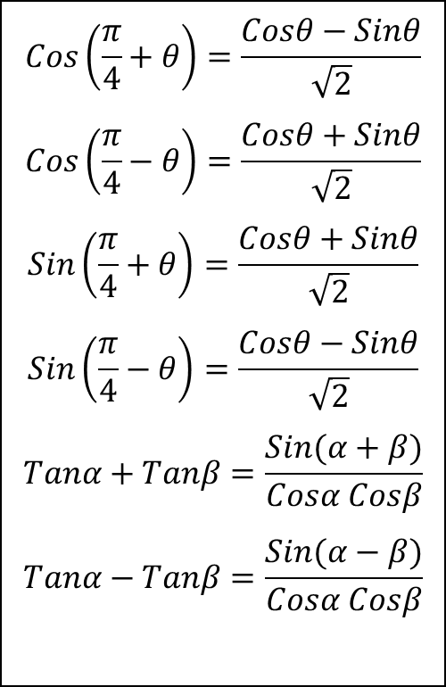
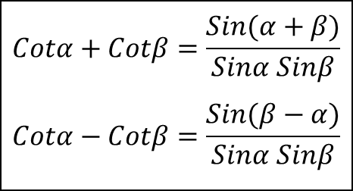
$$Cos\left(α+β\right)=Cosα Cosβ−Sinα Sinβ$$
$$Cos\left(α−β\right)=Cosα Cosβ+Sinα Sinβ$$
$$Sin\left(α+β\right)=Sinα Cosβ+Cosα Sinβ$$
$$Sin\left(α−β\right)=Sinα Cosβ−Cosα Sinβ$$
$$Tan\left(α+β\right)=\frac{Tanα+Tanβ}{1−Tanα Tanβ}$$
$$Tan\left(α−β\right)=\frac{Tanα−Tanβ}{1+Tanα Tanβ}$$
$$Cos\left(\frac{π}{4}+θ\right)=\frac{Cosθ−Sinθ}{\sqrt{2}}$$
$$Cos\left(\frac{π}{4}−θ\right)=\frac{Cosθ+Sinθ}{\sqrt{2}}$$
$$Sin\left(\frac{π}{4}+θ\right)=\frac{Cosθ+Sinθ}{\sqrt{2}}$$
$$Sin\left(\frac{π}{4}−θ\right)=\frac{Cosθ−Sinθ}{\sqrt{2}}$$
$$Tanα+Tanβ=\frac{Sin(α+β)}{Cosα Cosβ}$$
$$Tanα−Tanβ=\frac{Sin(α−β)}{Cosα Cosβ}$$
$$Cotα+Cotβ=\frac{Sin(α+β)}{Sinα Sinβ}$$
$$Cotα−Cotβ=\frac{Sin(β−α)}{Sinα Sinβ}$$
$$Tan\left(\frac{π}{4}+θ\right)=\frac{Cosθ+Sinθ}{Cosθ−Sinθ}$$
$$Tan\left(\frac{π}{4}−θ\right)=\frac{Cosθ−Sinθ}{Cosθ+Sinθ}$$

Slide 5
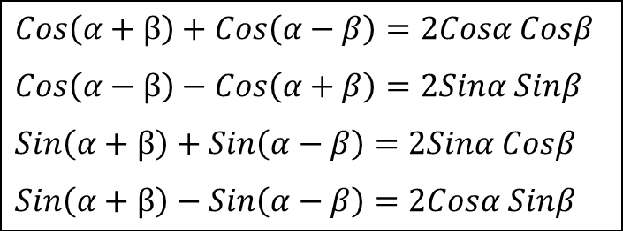
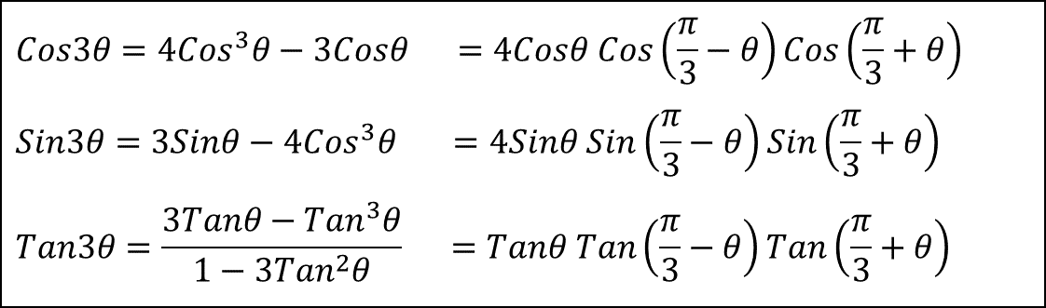
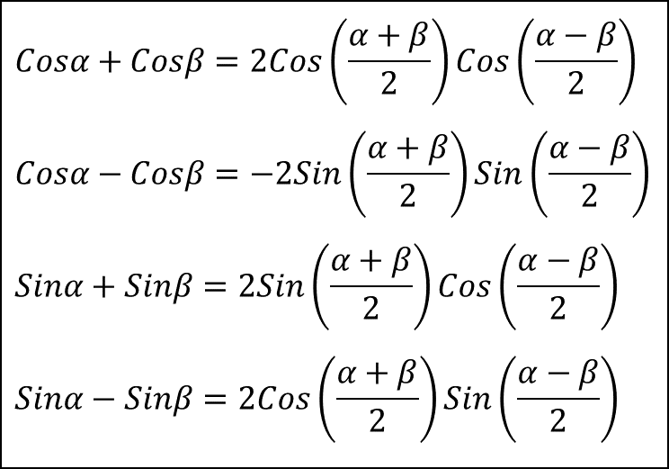
$$Cos3θ=4{Cos}^{3}θ−3Cosθ =4Cosθ Cos\left(\frac{π}{3}−θ\right)Cos\left(\frac{π}{3}+θ\right)$$
$$Sin3θ=3Sinθ−4{Cos}^{3}θ =4Sinθ Sin\left(\frac{π}{3}−θ\right)Sin\left(\frac{π}{3}+θ\right)$$
$$Tan3θ=\frac{3Tanθ−{Tan}^{3}θ}{1−3{Tan}^{2}θ} =Tanθ Tan\left(\frac{π}{3}−θ\right)Tan\left(\frac{π}{3}+θ\right)$$
$$Cosα+Cosβ=2Cos\left(\frac{α+β}{2}\right)Cos\left(\frac{α−β}{2}\right)$$
$$Cosα−Cosβ=−2Sin\left(\frac{α+β}{2}\right)Sin\left(\frac{α−β}{2}\right)$$
$$Sinα+Sinβ=2Sin\left(\frac{α+β}{2}\right)Cos\left(\frac{α−β}{2}\right)$$
$$Sinα−Sinβ=2Cos\left(\frac{α+β}{2}\right)Sin\left(\frac{α−β}{2}\right)$$
$$Cos\left(α+β\right)+Cos\left(α−β\right)=2Cosα Cosβ$$
$$Cos\left(α−β\right)−Cos\left(α+β\right)=2Sinα Sinβ$$
$$Sin\left(α+β\right)+Sin\left(α−β\right)=2Sinα Cosβ$$
$Sin\left(α+β\right)−Sin\left(α−β\right)=2Cosα Sinβ$

Slide 6
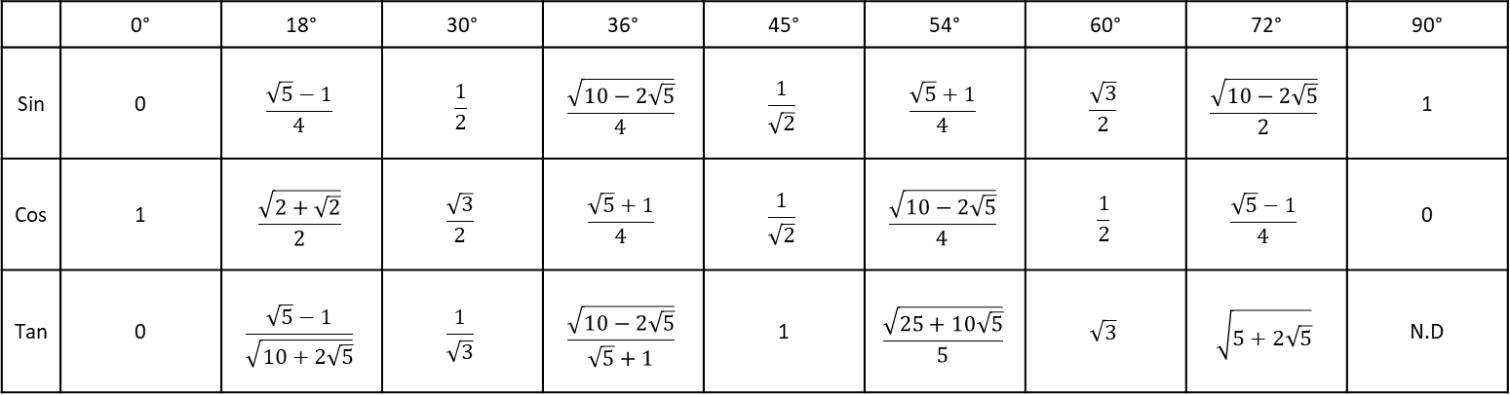
 | 0° | 18° | 30° | 36° | 45° | 54° | 60° | 72° | 90°
Sin | 0 | $$\frac{\sqrt{5}−1}{4}$$ | $$\frac{1}{2}$$ | $$\frac{\sqrt{10−2\sqrt{5}}}{4}$$ | $$\frac{1}{\sqrt{2}}$$ | $$\frac{\sqrt{5}+1}{4}$$ | $$\frac{\sqrt{3}}{2}$$ | $$\frac{\sqrt{10−2\sqrt{5}}}{2}$$ | 1
Cos | 1 | $$\frac{\sqrt{2+\sqrt{2}}}{2}$$ | $$\frac{\sqrt{3}}{2}$$ | $$\frac{\sqrt{5}+1}{4}$$ | $$\frac{1}{\sqrt{2}}$$ | $$\frac{\sqrt{10−2\sqrt{5}}}{4}$$ | $$\frac{1}{2}$$ | $$\frac{\sqrt{5}−1}{4}$$ | 0
Tan | 0 | $$\frac{\sqrt{5}−1}{\sqrt{10+2\sqrt{5}}}$$ | $$\frac{1}{\sqrt{3}}$$ | $$\frac{\sqrt{10−2\sqrt{5}}}{\sqrt{5}+1}$$ | 1 | $$\frac{\sqrt{25+10\sqrt{5}}}{5}$$ | $$\sqrt{3}$$ | $$\sqrt{5+2\sqrt{5}}$$ | N.D

